Slide 1
Slide 2 – From SDLC to DevOps
We have already discussed
Traditional SDLC
Requirements
Design
Development
Testing
Deployment
Maintenance
The Challenge
Modern organisations need:
Faster delivery
Continuous updates
Improved reliability
Rapid feedback
Better security
Key Message
DevOps extends SDLC by making delivery, feedback and improvement continuous.

Slide 2
BASIC PRESENTATION
Presented by Ares Grau

Slide 3
SDLC and
Agile

Slide 4
Lecture Structure (60 Minutes)
Section | Time
Introduction & Context | 5 mins
Why DevOps Exists | 10 mins
DevOps Principles & Culture | 15 mins
Modern DevOps Practices | 15 mins
Emerging Trends | 10 mins
Wrap-up & Questions | 5 mins

Slide 5

Introducing DevOps
By the end of this session you will be able to:
Explain
why DevOps emerged
Describe
the DevOps lifecycle
Understand
the CALMS framework
Explain
CI/CD and automation
Recognise
DevSecOps and Platform Engineering
Describe
the impact of AI on modern DevOps

Slide 6
From SDLC to DevOps
We have already discussed
Traditional SDLC
Requirements
Design
Development
Testing
Deployment
Maintenance
The Challenge

Slide 7
Modern development needs
Faster delivery
Continuous updates
Improved reliability
Rapid feedback
Better security
Key Message
DevOps extends SDLC by making delivery, feedback
and improvement continuous

Slide 8









Software development never ends
Modern lifecycle requires
Plan
Code
Build
Test
Release
Deploy
Operate
Monitor
Discussion
Why is monitoring considered part of development?
Code
Deploy
Plan
Operate
Release
Test
Monitor

Slide 9
The problems DevOps tries to solve
Common Organisational Challenges
Slow releases
Environment inconsistencies
Blame culture
Poor communication
Manual deployments
Security issues discovered too late
Unreliable production environments
Question
Have you experienced any of these?

Slide 10
The Wall of Confusion
Use existing concept from the original deck.
Traditional View
Development:
Wants rapid change
Operations:
Wants stability
Result
Conflict, delays and finger-pointing.

Slide 11
Slide 6 – What DevOps Really Means
DevOps Is Not A Job Title
DevOps is:
A culture
A way of working
A set of practices
A shared responsibility model
Goal
Deliver value safely and quickly.

Slide 12

CALMS Framework
C.A.L.M.S
Culture
Automation
Lean
Measurement
Sharing
This framework is still widely used to explain DevOps foundations. Based on the CALMS model already introduced in your original deck.

Slide 13

Culture
High-Performing Teams
Shared ownership
Collaboration
Transparency
Continuous learning
Trust
Blameless retrospectives
Modern Mindset
Fail, learn, improve.

Slide 14
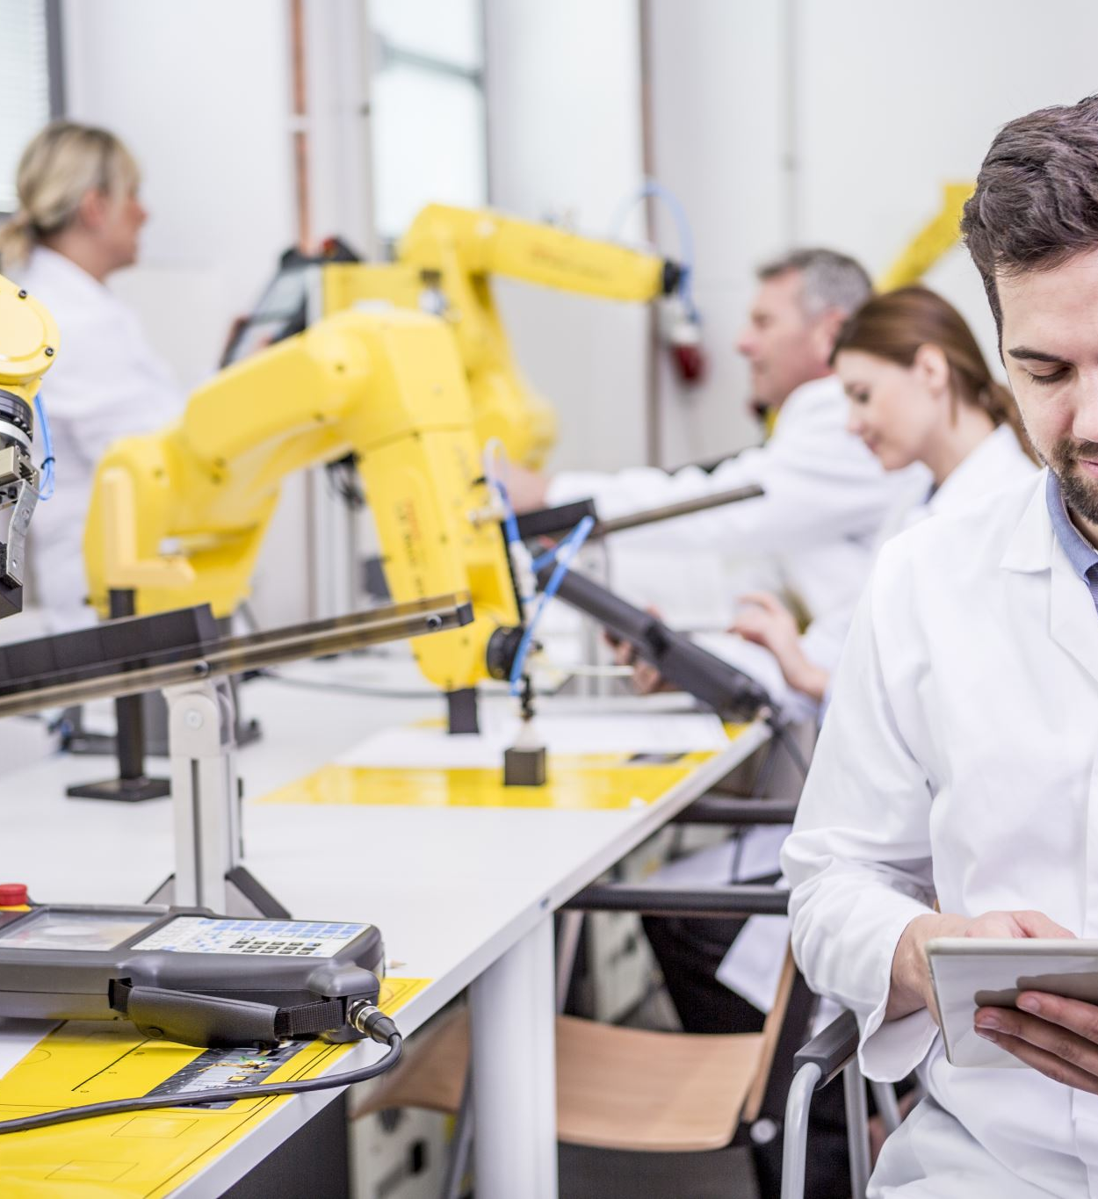
Automation of repetitive activities
Builds
Testing
Deployment
Infrastructure provisioning
Monitoring
Security scanning
Benefits
Consistency
Speed
Reliability
Reduced errors

Slide 15
Continuous Integration And Continuous Delivery
Continuous Integration (CI)
Developers merge code frequently.
Every change triggers:
Build
Automated testing
Validation
Continuous Delivery (CD)
Software is always ready for release.
Continuous Deployment
Every successful change automatically reaches production.

Slide 16

Devsecops
Security Is Everyone's Responsibility
Traditional approach:
Security at the end.
Modern approach:
Security throughout development.
Do:
Automated vulnerability scanning
Dependency checking
Secret scanning
Compliance checks
Shift Left Security
Find issues earlier and cheaper.

Slide 17

Modern Cloud-native Devops
Instead of:
Physical servers
Manual configuration
We increasingly use:
Containers
Kubernetes
Serverless platforms
Infrastructure as Code
Cloud services
Benefits
Scalability
Reproducibility
Faster deployment

Slide 18
Measuring Success
DORA Metrics
Four common performance measures:
Deployment Frequency
Lead Time for Changes
Change Failure Rate
Mean Time To Recovery (MTTR)
Key Principle
What gets measured gets improved.

Slide 19
Platform Engineering
Emerging Practice
Operations teams increasingly build:
Internal Developer Platforms
Providing:
Self-service environments
Standard deployment processes
Standard monitoring
Standard security controls
Benefit
Developers focus on building software.

Slide 20
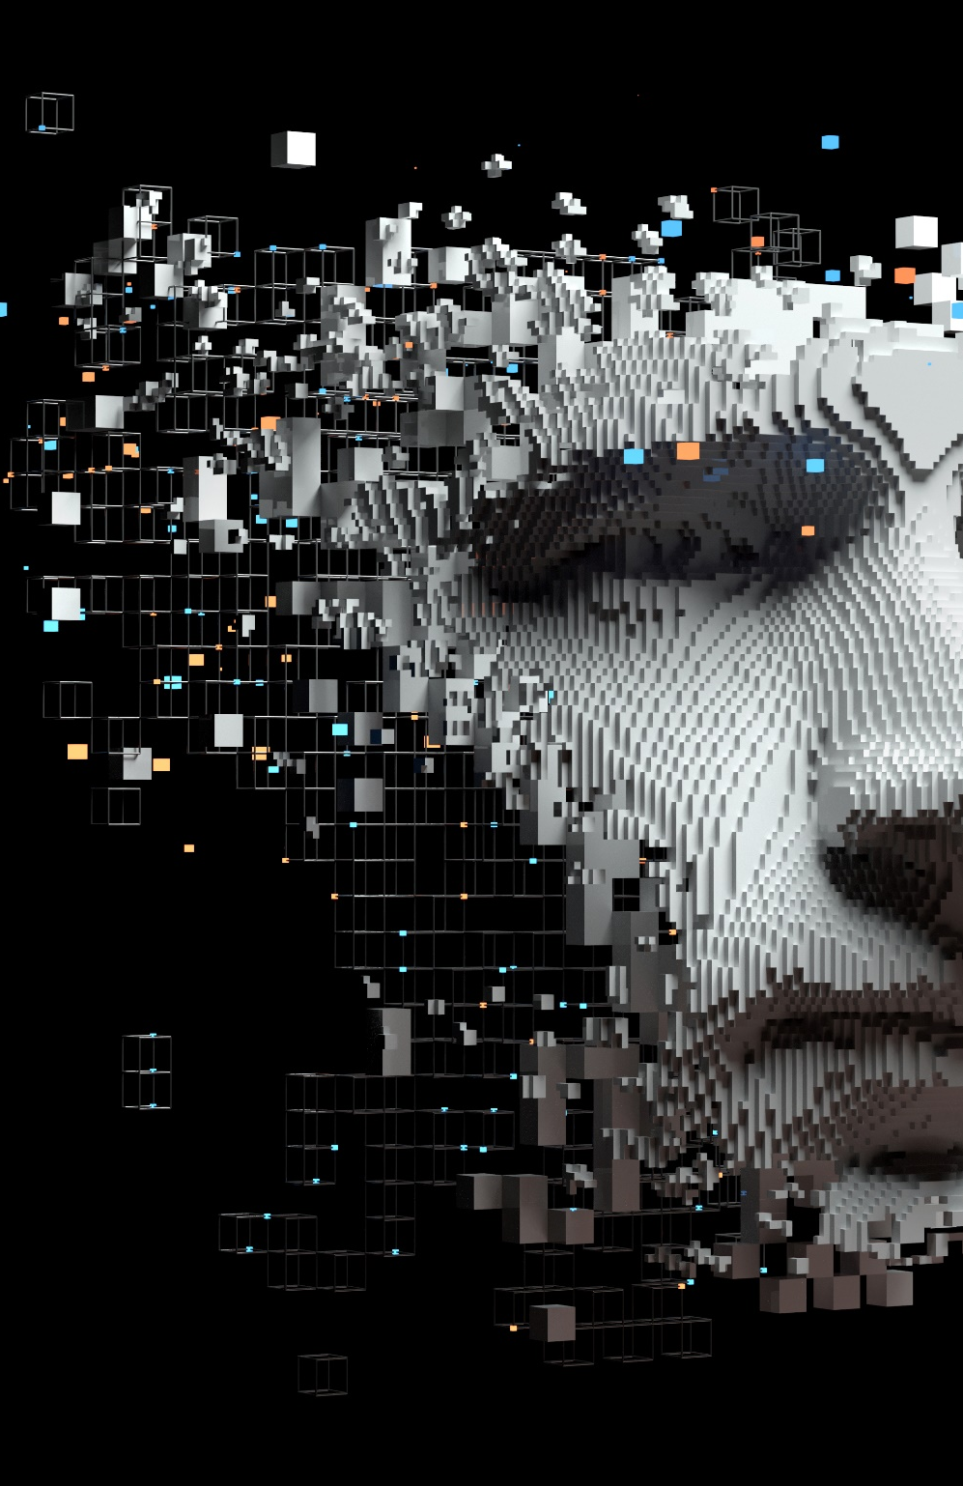
AI And Devops
How AI Is Changing DevOps
Examples:
AI coding assistants
Automated test generation
Incident investigation
Log analysis
Security analysis
Predictive monitoring
Important
AI assists engineers.
It does not replace engineering judgement.

Slide 21
Summary
DevOps extends traditional SDLC
DevOps is primarily about culture
Automation enables speed and consistency
Security is everyone's responsibility
Cloud, Platform Engineering and AI are shaping modern DevOps
Continuous improvement never stops
If your organisation adopted only one DevOps principle tomorrow, which would have the biggest impact?

